Slide 1

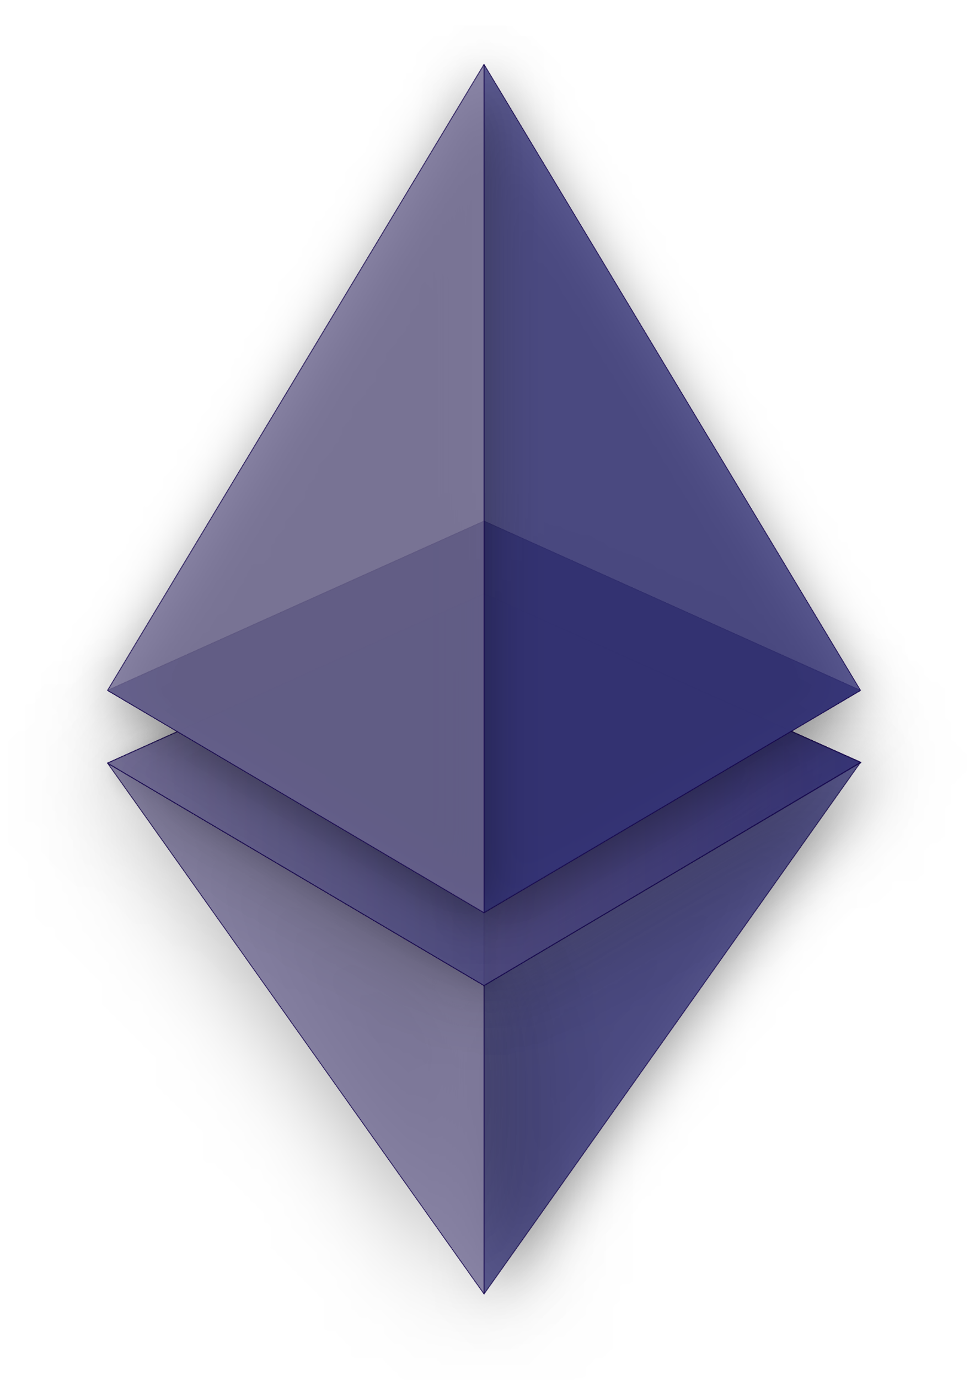
Helpseekers
a web 3.0 based dapp
Notes:
1. Table of contents
2. Introduction
3. Our company
4. Our team
5. Problem
6. Them vs. us
7. Solution
8. SWOT analysis
9. Product overview
10. Our plans
11. Product demo
12. Traction
13. Case study
14. Reviews
15. Awards
16. Market size
17. Target
18. Competitors
19. Business model
20. Timing
21. Predicted growth
22. Investment

Slide 2

Team Members
Mohammad Enan Al Harun Sahan
ID: 20101095
Md. Asadujjaman Noor
ID: 20101101
Sheikh Nafez Sadnan
ID: 20101106

Slide 3
Project Overview
Conflicting requirements
01
04
Impact on Society
02
05
How P and K s are addressed through the project and mapping
Critical Challenges
Project Management
03
06
Problem definition, Objectives and Outputs
Necessary and unnecessary difficulties
Motivation, Social Impact
Development hurdles
Time table and cost analysis

Slide 4
01
Project Overview

Slide 5

PROBLEM DEFINITION
SECURITY
COMPANY
Enhancing Transparency and Security in Crowdfunding with a Blockchain-Based Decentralized Application (Dapp)

Slide 6

OBJECTIVES
The objective of this project is to develop a robust and user-friendly blockchain-based crowdfunding decentralized application (Dapp) that addresses the shortcomings of traditional crowdfunding platforms while ensuring transparency, security, and efficiency.

Slide 7
PROJECT OUTPUTS
The project will culminate in the development and deployment of a cutting-edge blockchain-based crowdfunding Dapp. The key output components include:
Blockchain Crowdfunding Dapp
Transparent Ledger
Secure Smart Contracts
Scalability Solutions
User-Friendly Interface
Legal Compliance.
Reputation System
Integration with Traditional Systems
Data Privacy Measures
Network Security
Interoperability/Standardization

Slide 8

02
Impact on society

Slide 9
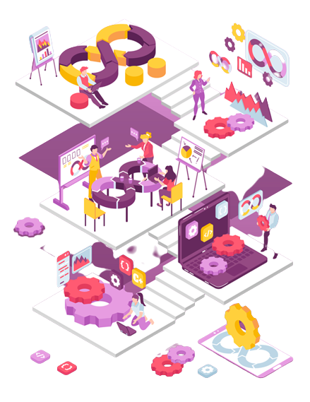
SOCIAL IMPACT
Social Impact:
The development and adoption of a blockchain-based crowdfunding Dapp can have profound social impacts, including:
Financial Inclusion
Transparency and Trust
Global Collaboration
Reduced Intermediaries

Slide 10
MOTIVATION
Transforming Crowdfunding Paradigm
Empowering Innovation & Inclusion
Blockchain's Potential for Change

Slide 11
03
Critical Challenges

Slide 12
Critical Challenges
Designing a good problem set
Building a robust judging system
Creating a user-friendly interface
Developing the judging system
Ensuring security
Promoting the platform
Provided challenges should be engaging and interesting.
The system must be robust and reliable. It needs to be capable of handling large number of submissions.
The interface should be intuitive and responsive.
System should be proficient in evaluating code based on the problem definition, input and output format, and time and memory constraints.
The platform should be secure enough to prevent cheating and hacking.
Once the platform is built, it is important to promote it to attract users.

Slide 13
CONFLICTING REQUIREMENTS
04

Slide 14

Conflicting Requirements
Our server needs to be fast and responsive - provide the result, point out the error and update the leader board almost instant.
But in test or contests some time the result will only show if it can be accepted and update the leaderboard after the contest is over.

Slide 15
05
How P and K s are addressed through the project and mapping

Slide 16
How K’s are addressed through the project and mapping
Ks | Attribute | How Ks are addressed through the project | COs | POs
K1 | Complex Engineering | VS Code, Solidity, Pycharm, Python Libraries for Web Development | CO1, CO2 | PO-(a), PO-(b)
K3 | Engineering Discipline | Github, Grant Chart, Codeblocks, HTML viewer, Browser | CO1, CO2 | PO-(a), PO-(b),
K4 | Specialist Knowledge | Figma for HTML UI/UX Design | CO1, CO2 | PO-(a), PO-(b)
K5 | Engineering Design | Python, HTML, Bootstrap, JavaScript, DB Browser | CO3 | PO-(c)
K6 | Engineering Practice | VS Code, Pycharm, Github | CO9 | PO-(k)
K8 | Research Literature | The Programming Journal | CO5 | PO-(d)

Slide 17
How P’s are addressed through the project and mapping
Ps | Attribute | How Ps are addressed through the project | COs | POs
P1 | Depth of knowledge required | This system requires mathematical knowledge, engineering fundamentals to set question for contestants to solve (K2). Identify, formulate and analyze complex engineering problems to reach conclusion (K3). Problem will be set by professionals (K4). | CO1, CO2, CO5 | PO-(a), PO-(b), PO-(d)
P2 | Range of conflicting requirements | The server needs to be fast and responsive. Provide the result, point out the error and update the leader board almost instant. But in test or contests some time the result will only show if it can be accepted and update the leaderboard after the contest is over. | CO6, CO7 | PO-(c), PO-(g)

Slide 18
How P’s are addressed through the project and mapping
P4 | Familiarity of issues | Contest with lot of participants can slow down the server decreasing the server performance. | CO7, CO8 | PO-(i), PO-(j)
P7 | Interdependence | Interdependency subsystem like Data Collection Problem organization Generate results Working IDE | CO4, CO9 | PO-(e), PO-(k)

Slide 19
06
PROJECT MANAGEMENT

Slide 20
TIME-TABLE AND COST ANALYSIS
Activity | Time Cost | Estimated expense in Taka
Information gathering | 160 Hours | 50000
Pre-production setup | 170 Hours | 50000
Setting up user experience | 250 Hours | 100000
Database setup | 270 Hours | 50000
Server management | Project lifetime | 200000+
UI development | 320 Hours | 125000
Documentation | 50 Hours | 25000
Approximate Project Costs | 1220 and more | 600000

Slide 21

Thank you!

